Slide 1
Basics of Automation Technology
Festo Didactic SE
www.festo-didactic.com
Copyright Festo Didactic 2020

Slide 2
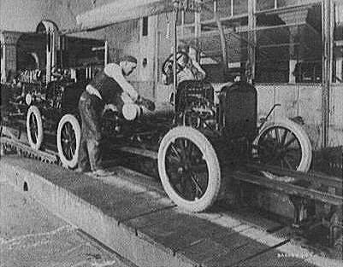
Manufacturing of Cars at Ford

Slide 3
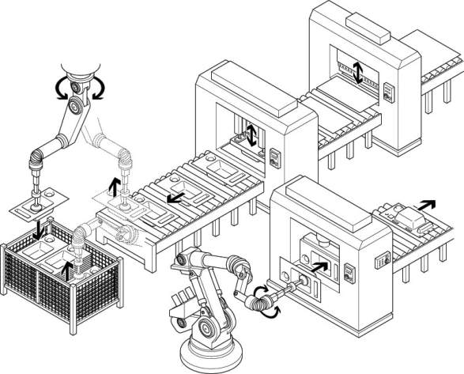
Automated Assembly Line

Slide 4
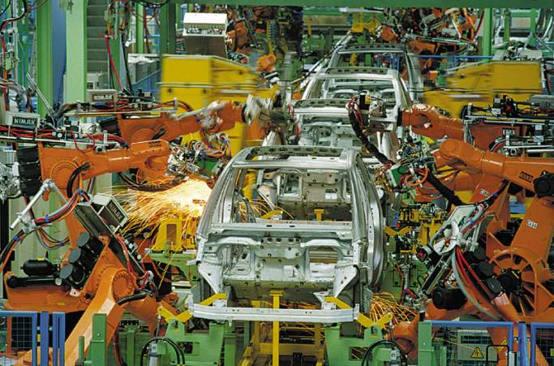
Production of Cars with Industrial Robots

Slide 5
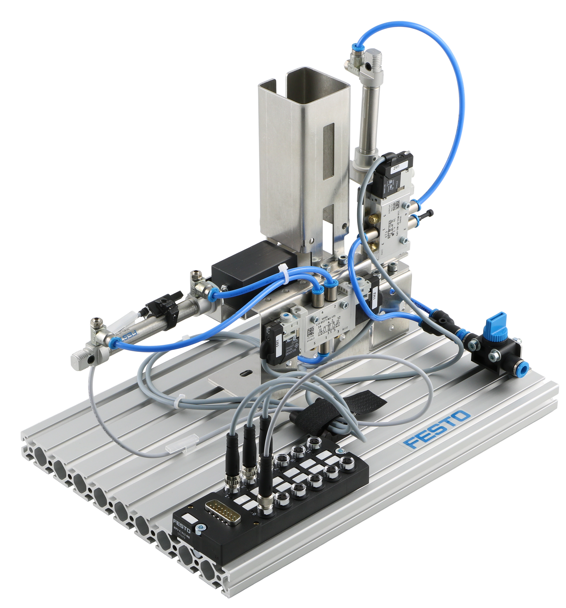
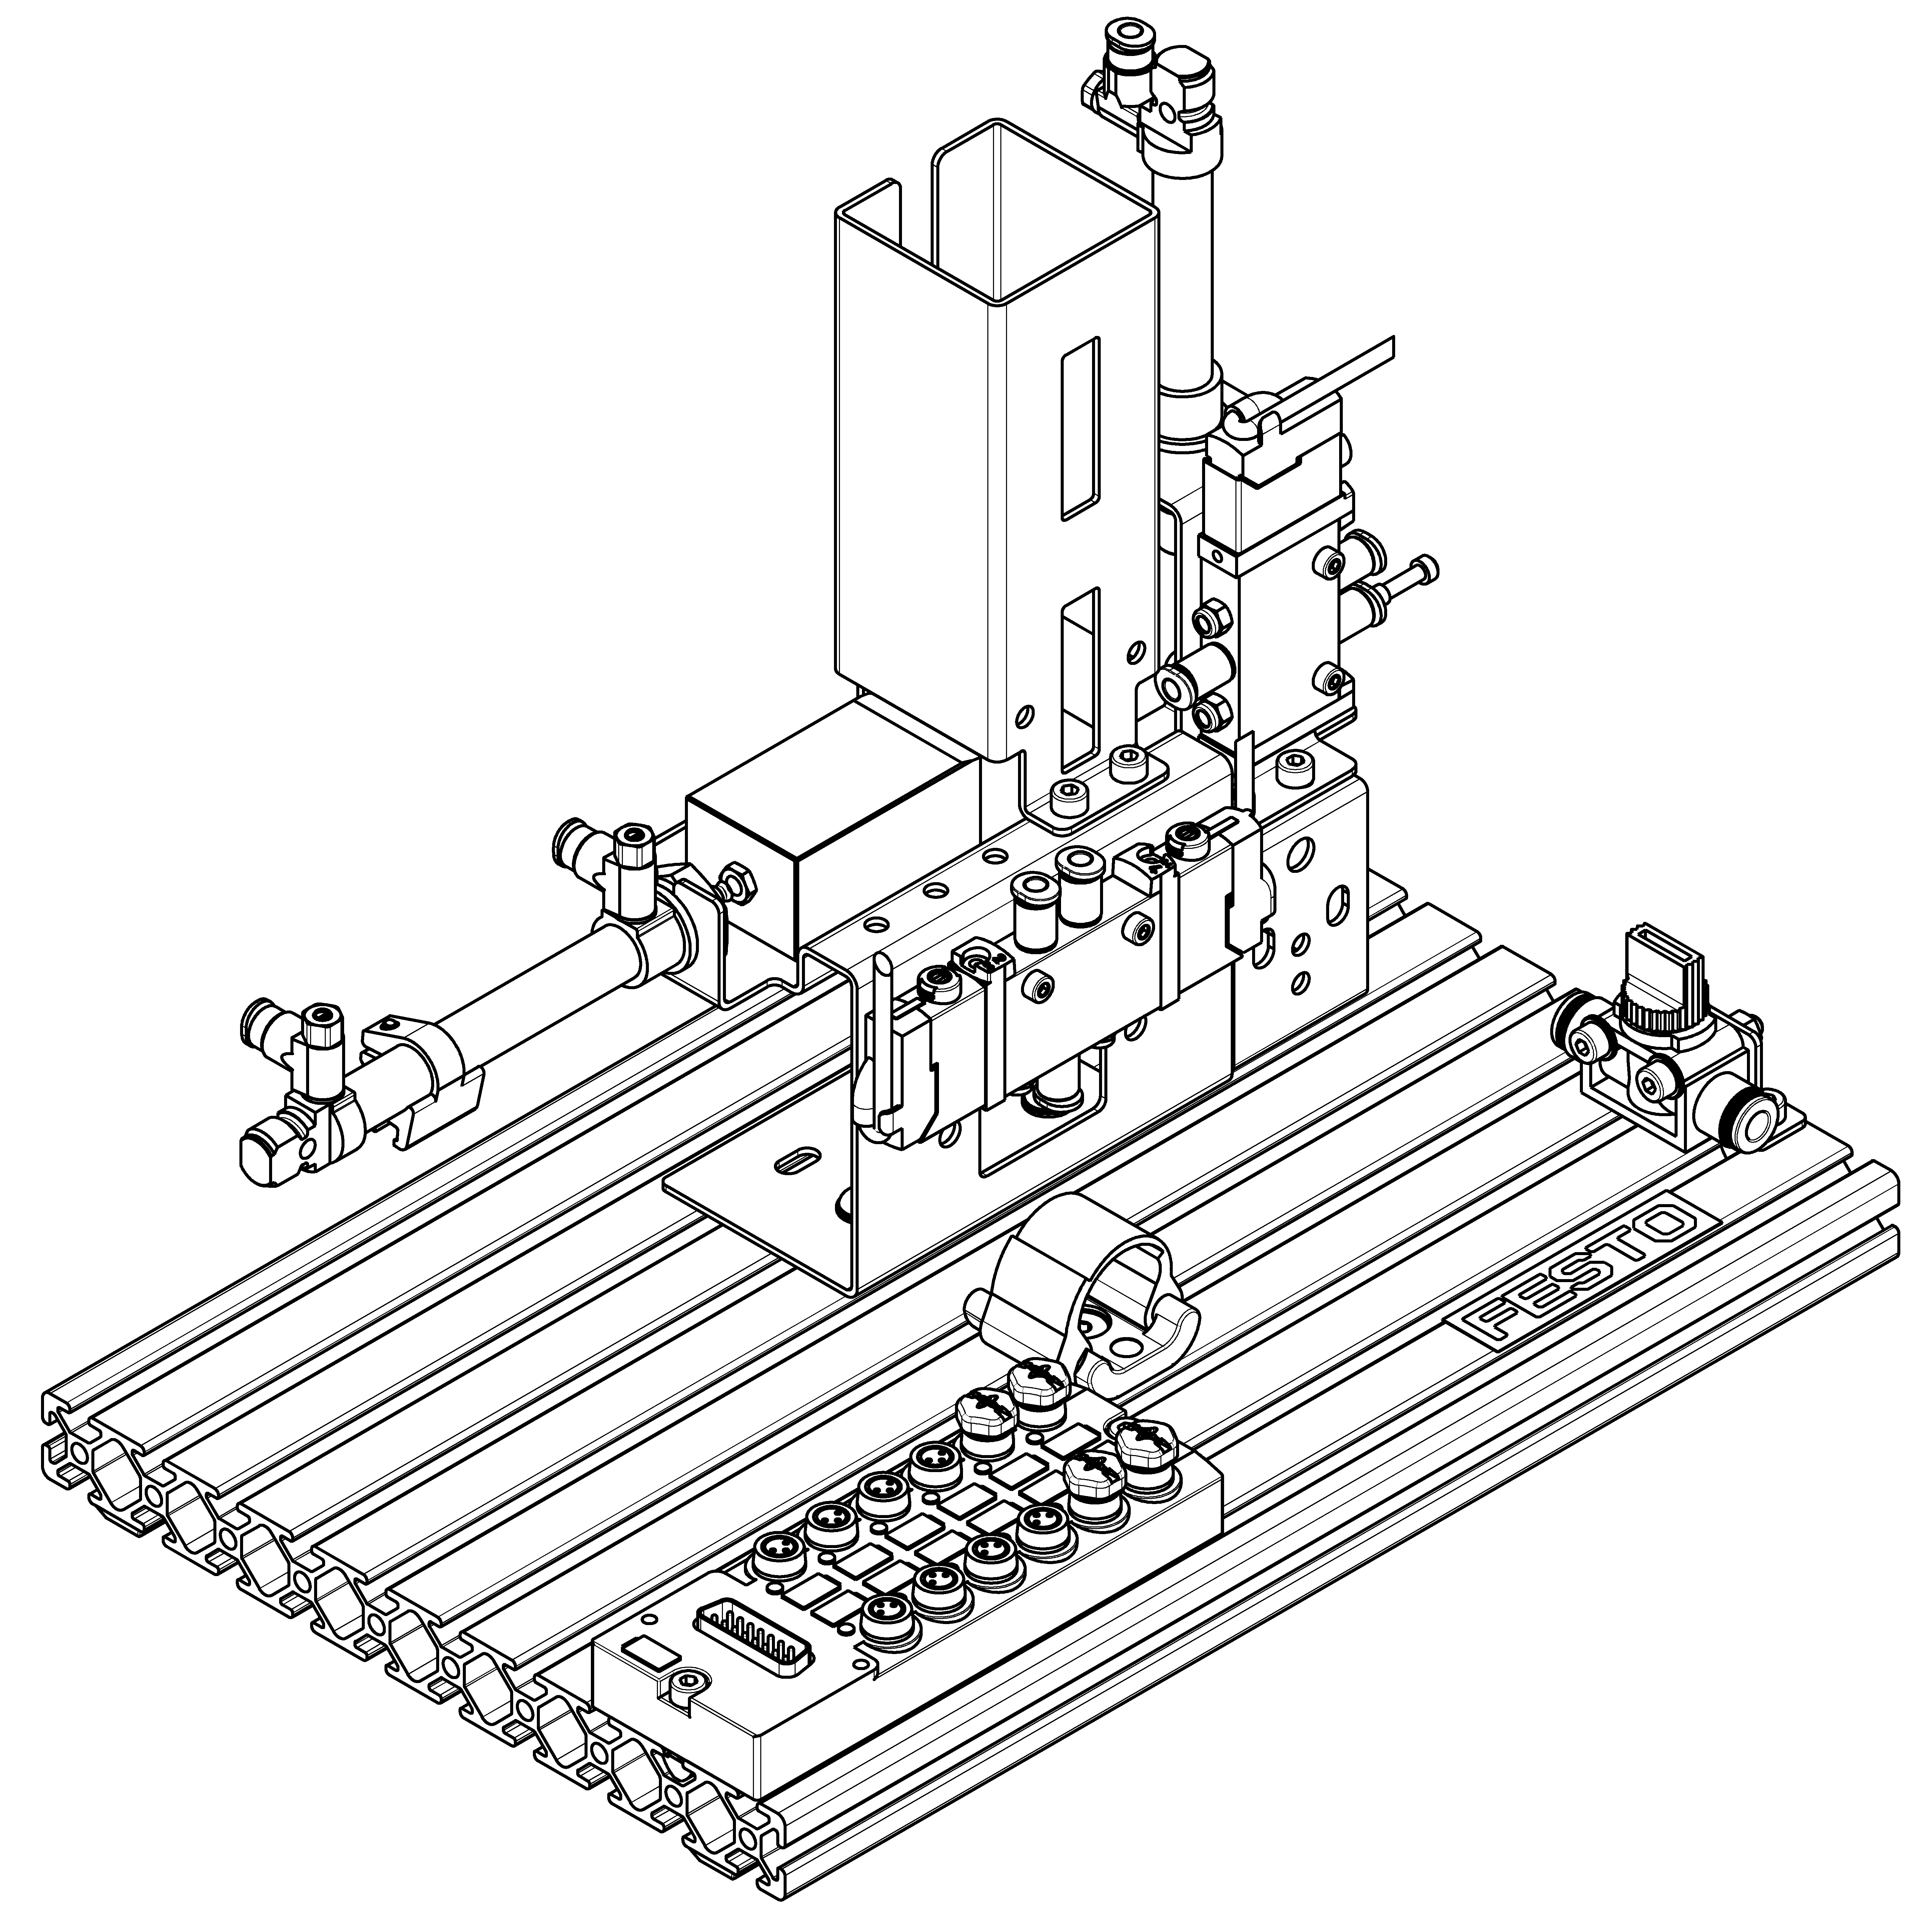
MecLab® Station Stack Magazine

Slide 6
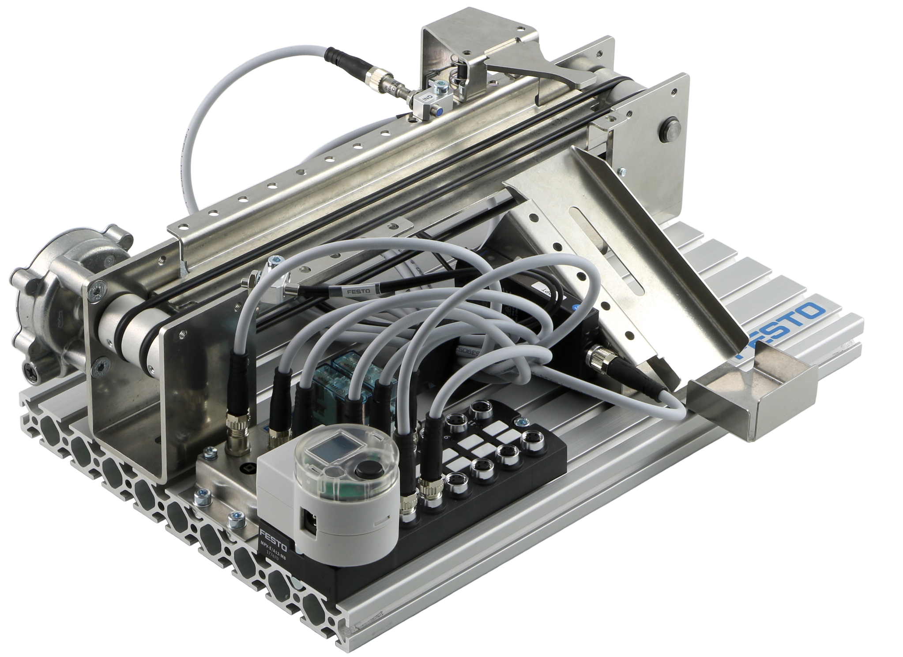
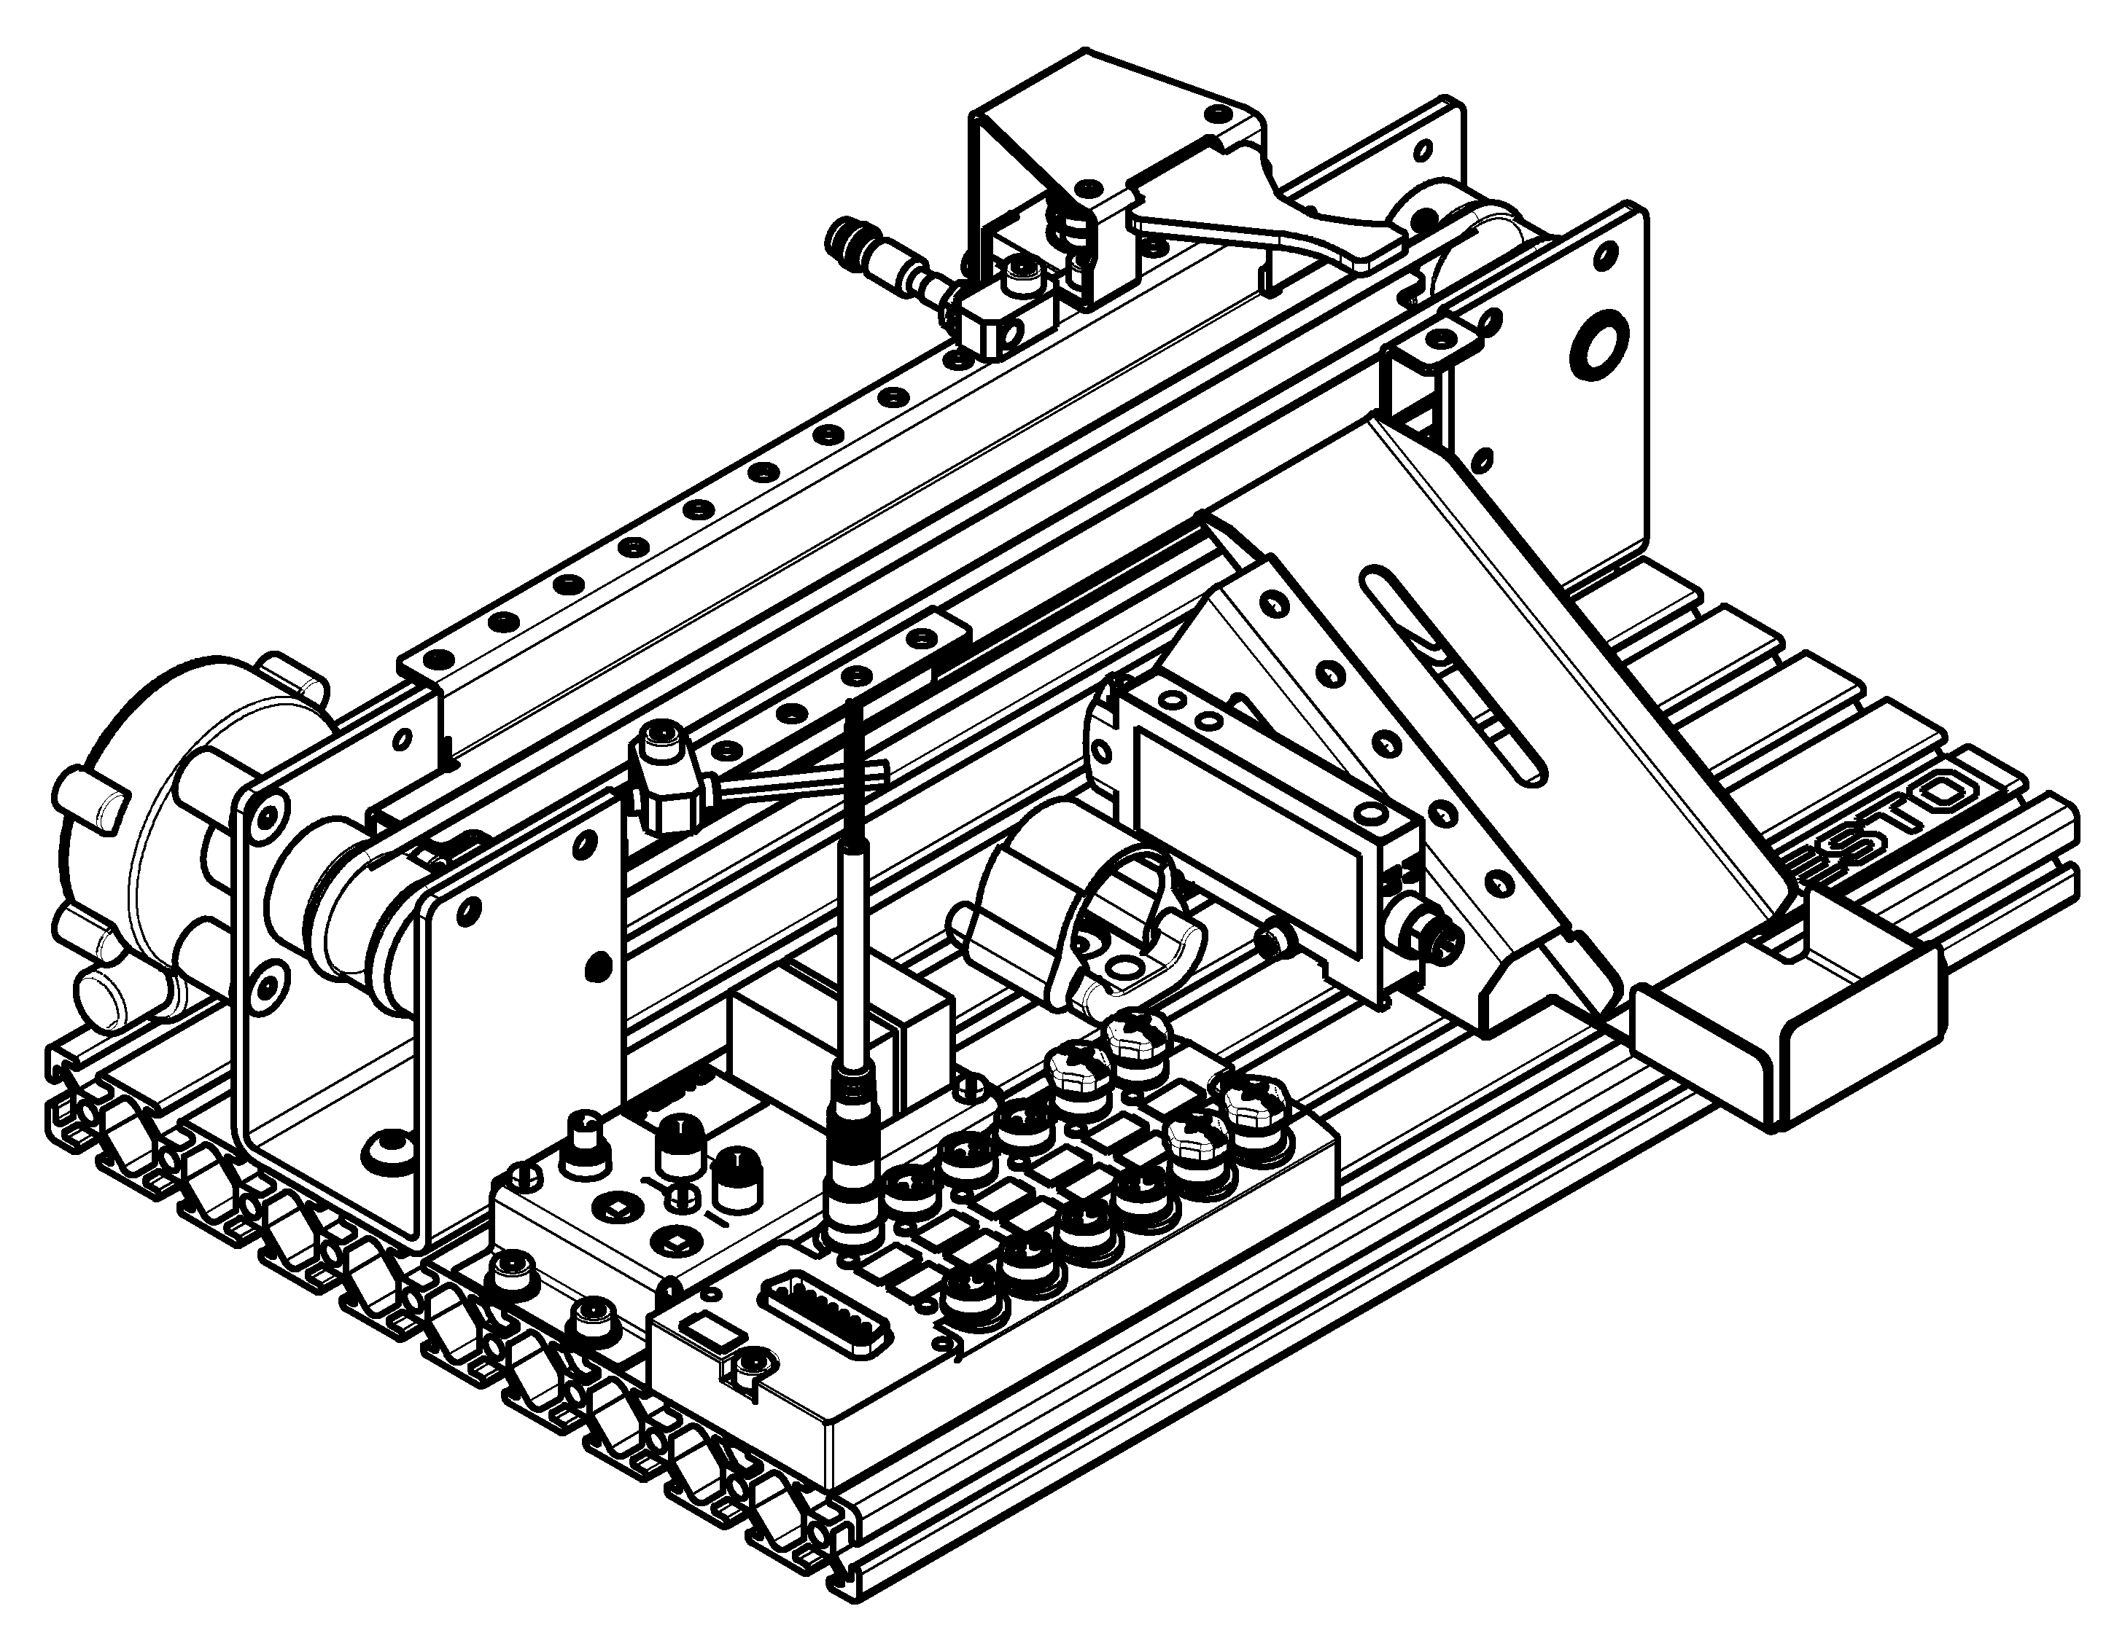
MecLab® Station Conveyor

Slide 7
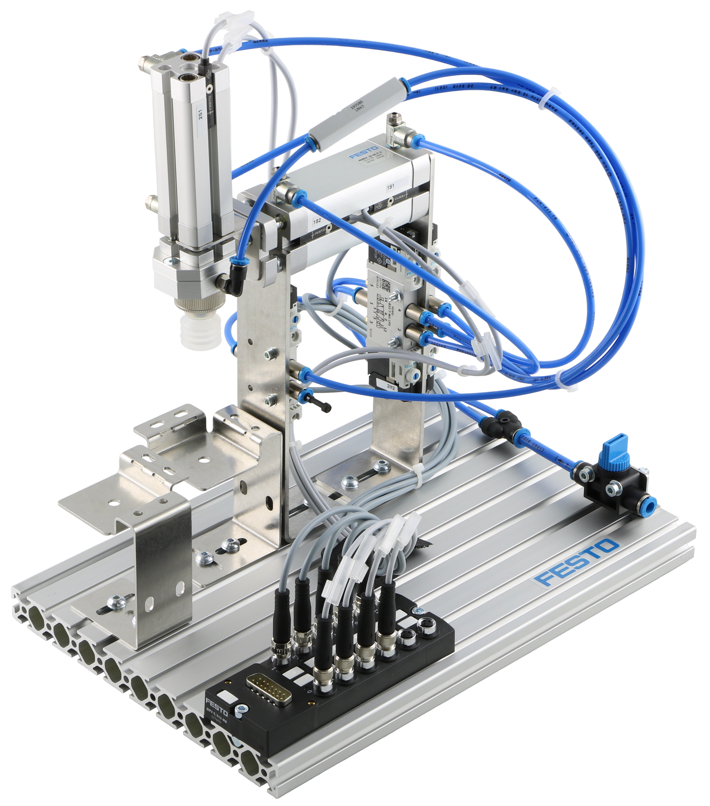
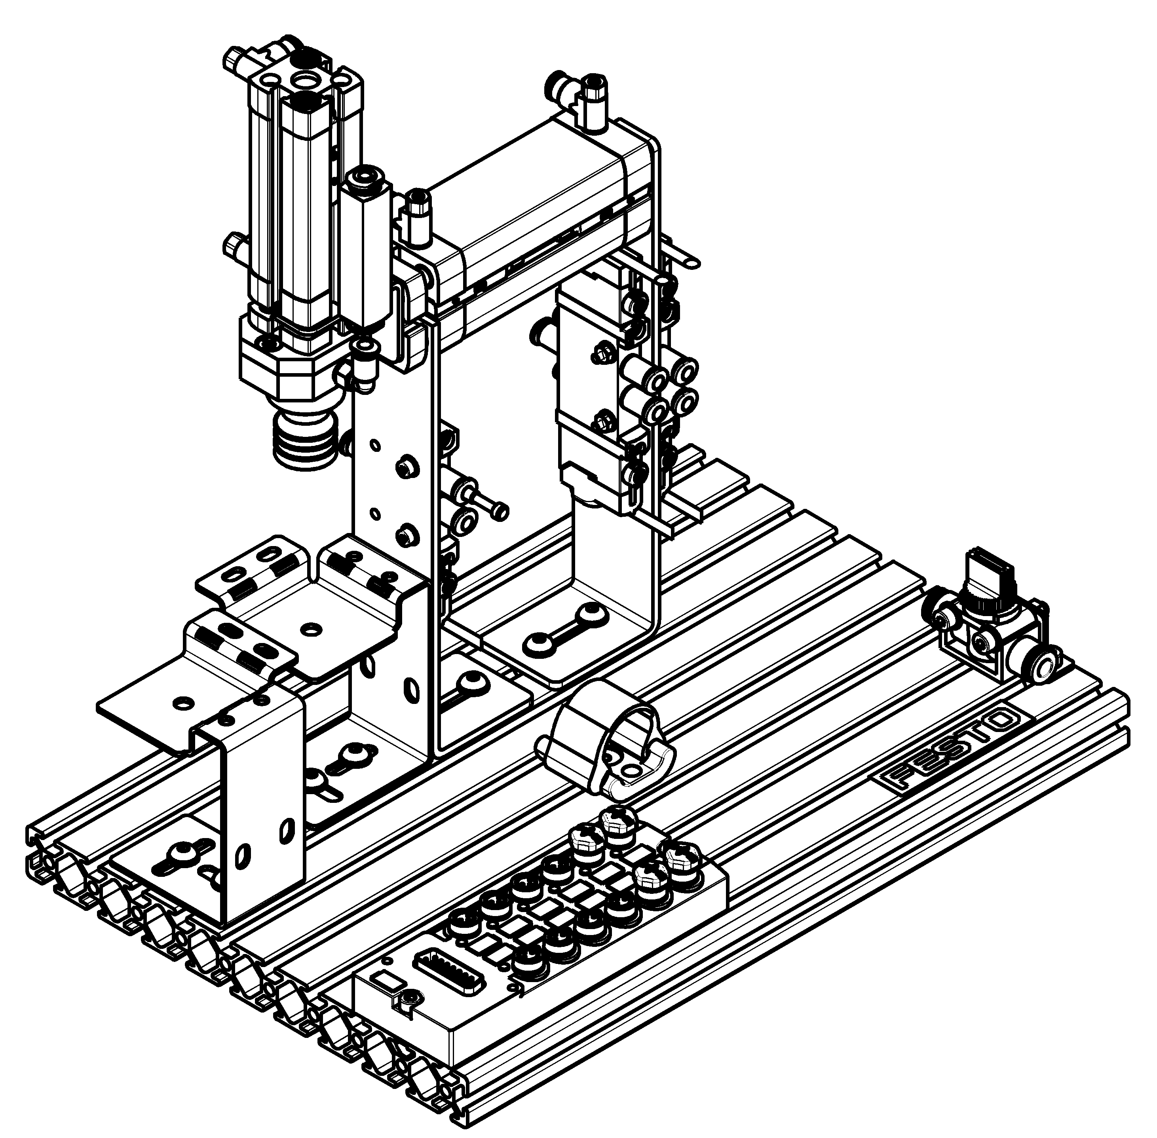
MecLab® Station Handling

Slide 8
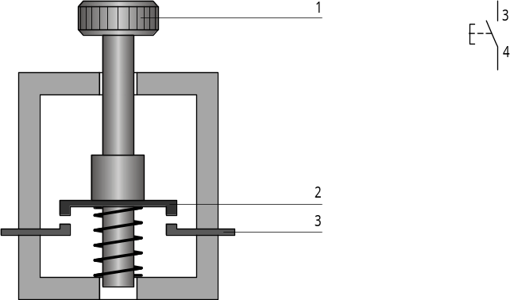
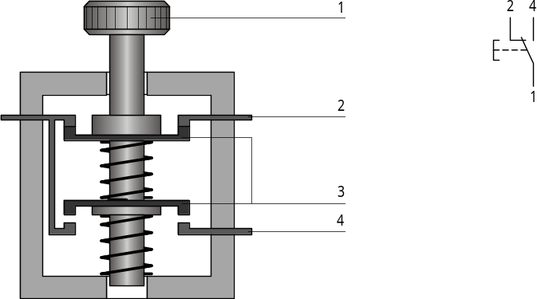
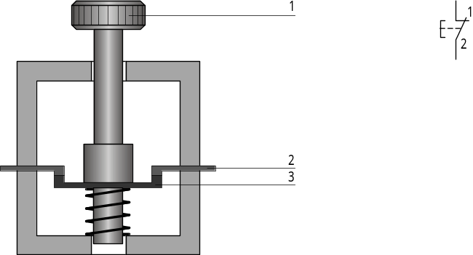
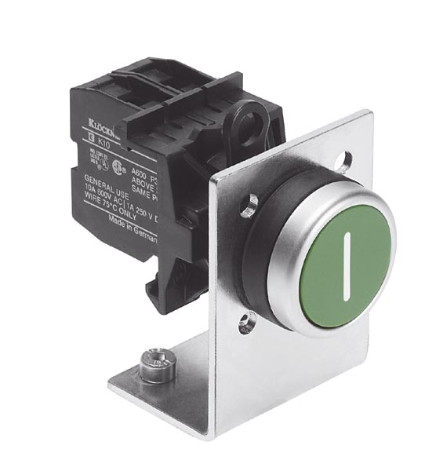
Electrical Switches
Normally open contact
toggle switch
Normally closed contact

Slide 9
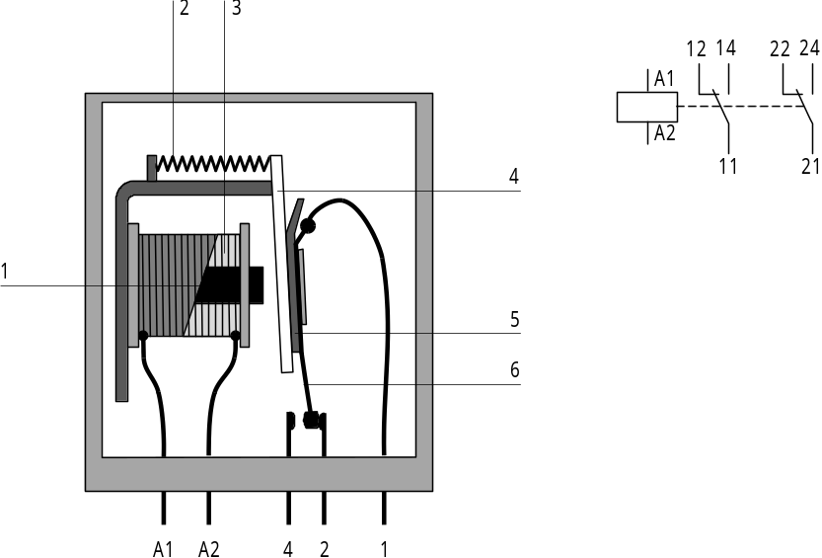
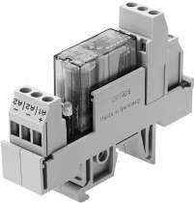
Relais

Slide 10
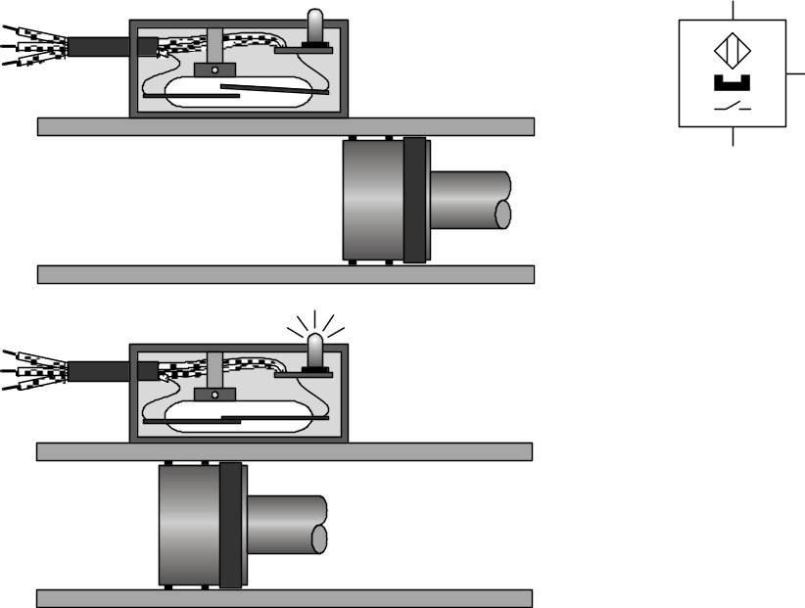
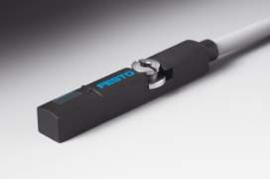
Proximity Switches for Pneumatical Cylinders
Barrel
Piston with Magnet

Slide 11
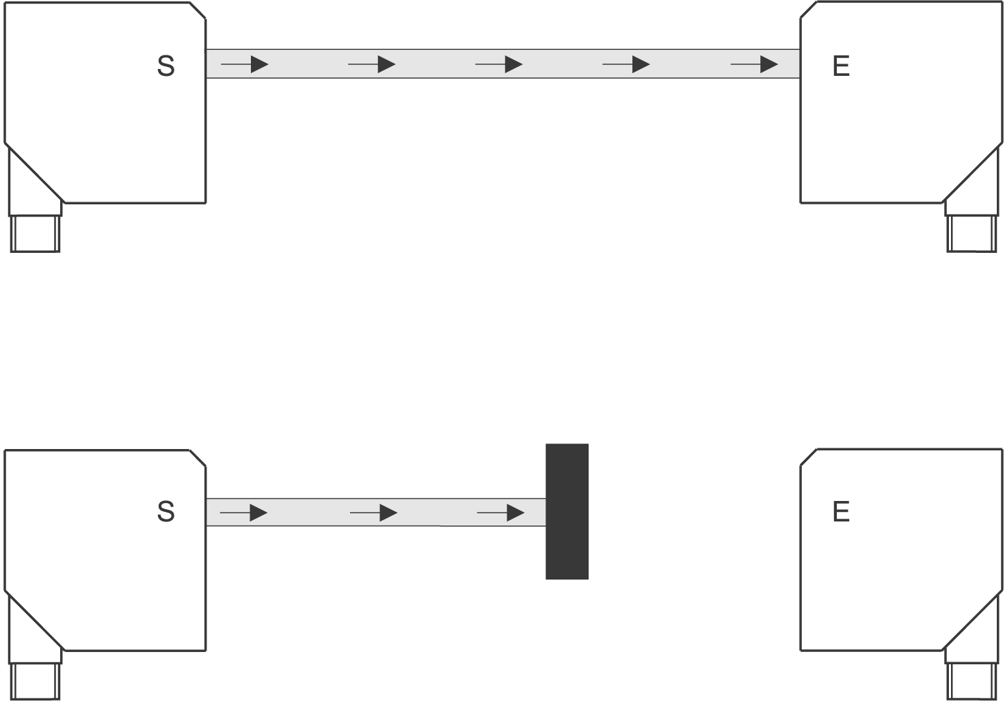
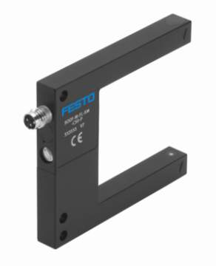

Optical Proximity Switches (Thru Beam)
Transmitter
Without Object
Receiver
With Object
Transmitter
Receiver

Slide 12
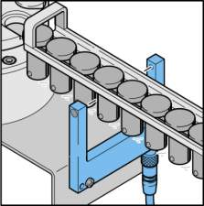
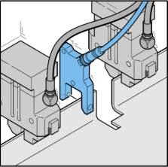
Thru Beam Sensor - Applications
Standstill control in feeding units
Parts detection in handling devices and transfer presses

Slide 13
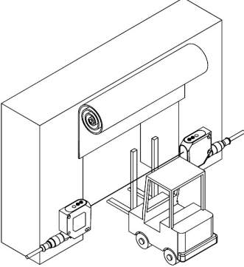
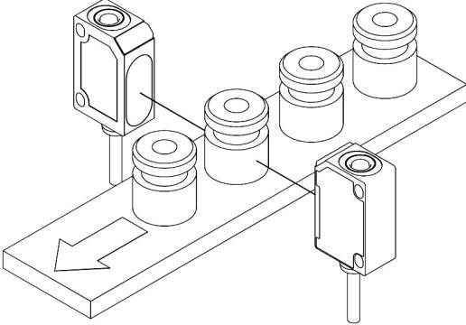
Thru Beam Sensor – Applications (II)
Object detection at long distances
Object detection in harsh environments

Slide 14
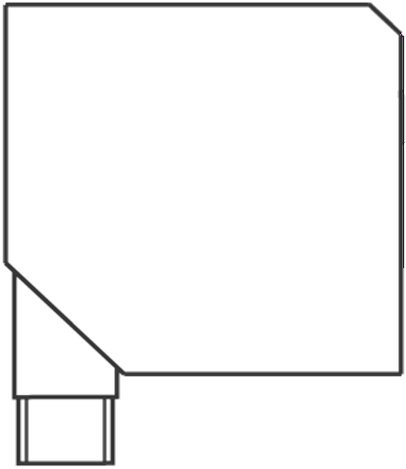
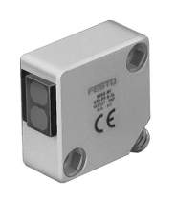
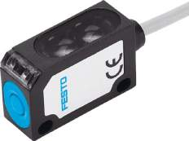
Optical Proximity Switches – Retro Reflective Sensor
E
S
Without Object
E
S
With Object
Retro-Reflective Sensor
Transmitter + Receiver
Mirror

Slide 15
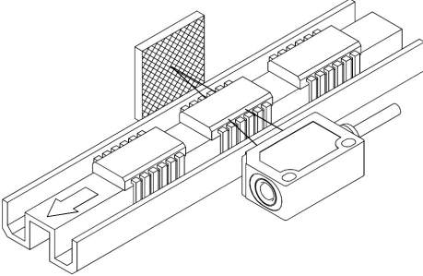
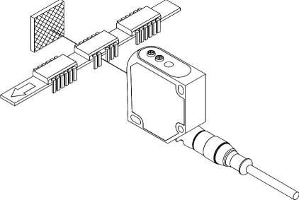
Retro Reflective Sensor - Applications
Position control of small objects
IC-pins control

Slide 16

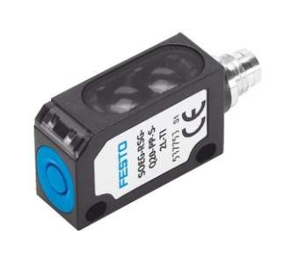
Optical Proximity Switches – Diffuse Sensor
E
S
Without Object
E
S
With Object
Diffuse Sensor
Transmitter + Receiver
Object

Slide 17
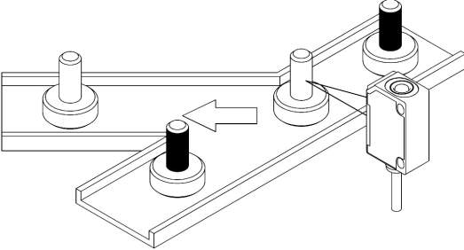
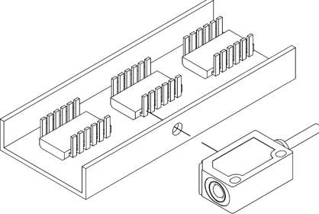
Diffuse Sensor - Applications
Recognition of objects with different contrasts
IC-Pin inspection

Slide 18
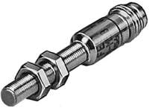

Inductive Proximity Switches
Without Object
With Object
Oscillator
core
coil
Magnetic Field

Slide 19
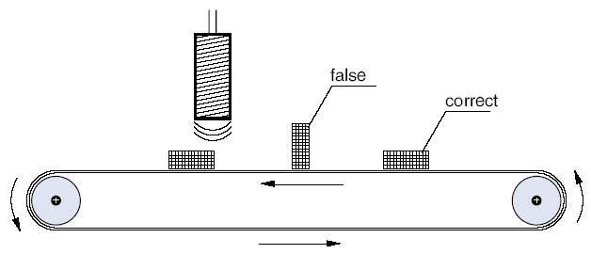
Inductive Sensors - Applications
Object Detection

Slide 20
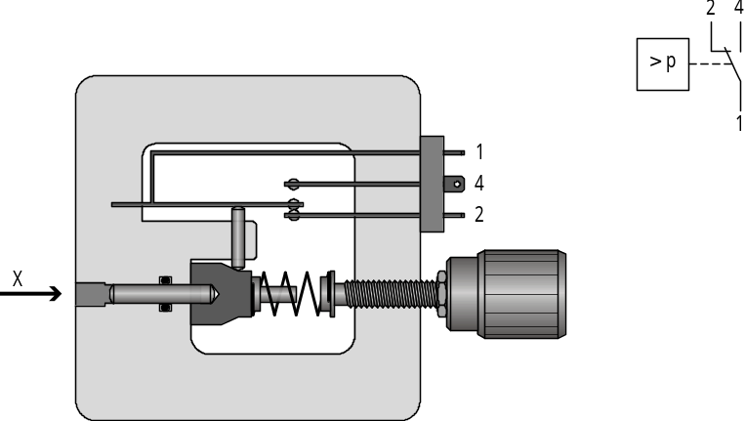
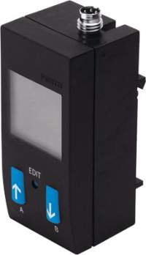
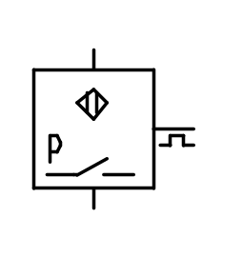
Pressure Switch

Slide 21
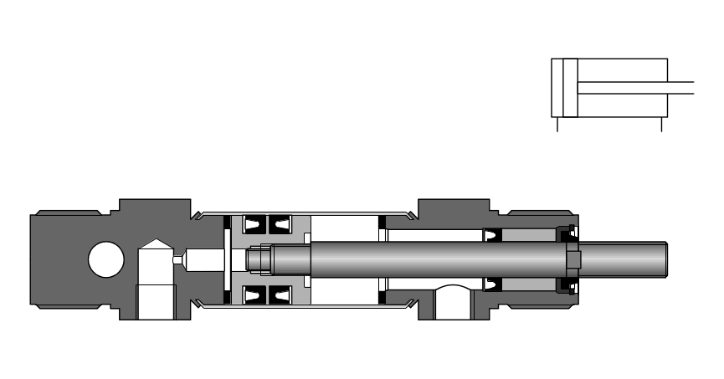
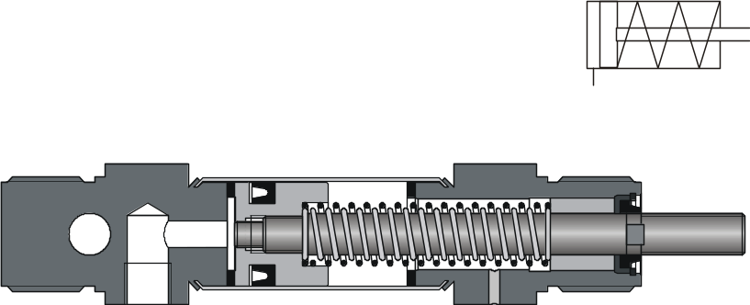
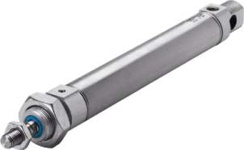
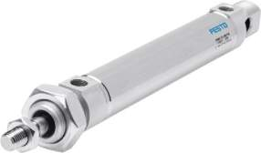
Single and Double Acting Cylinder

Slide 22
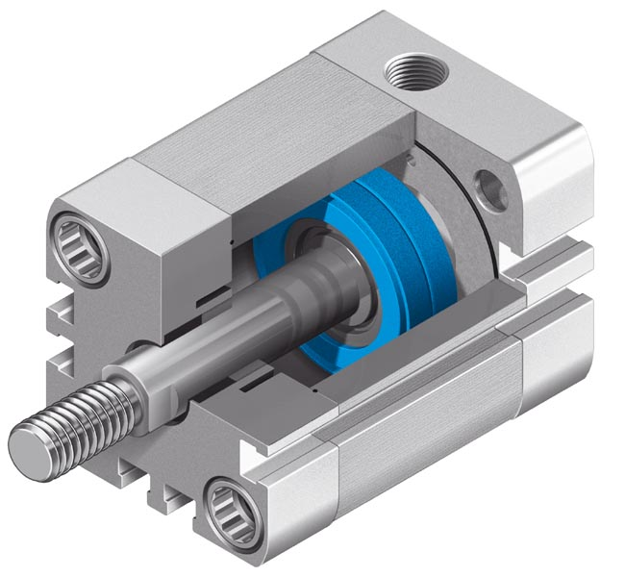
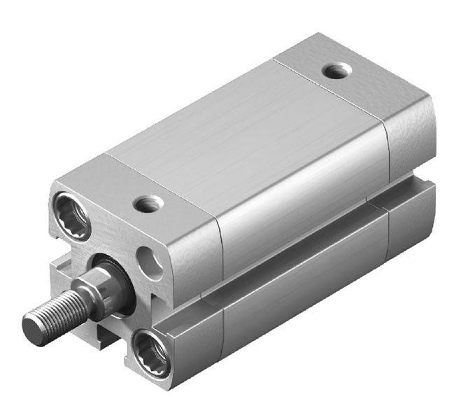
Profile Cylinder

Slide 23
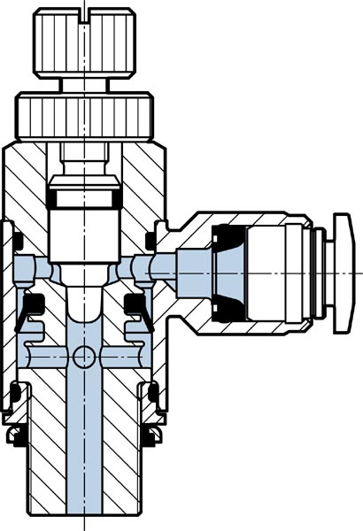
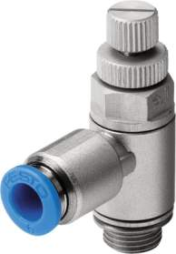
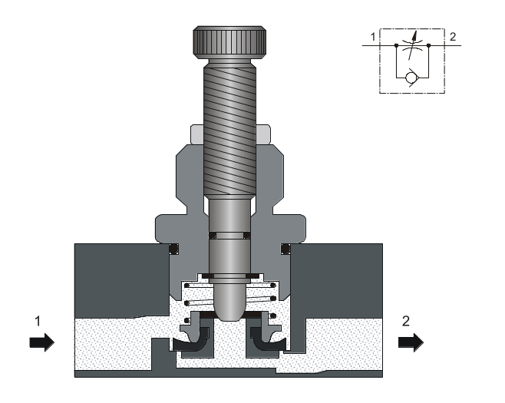
One Way Flow Control Valve

Slide 24
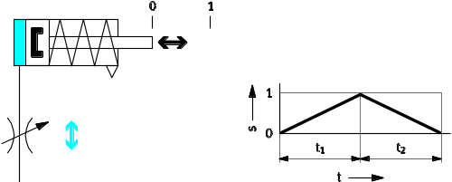
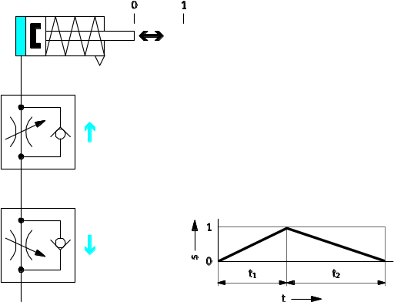
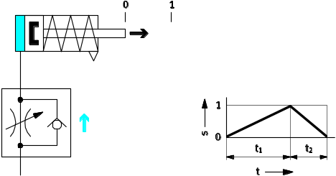
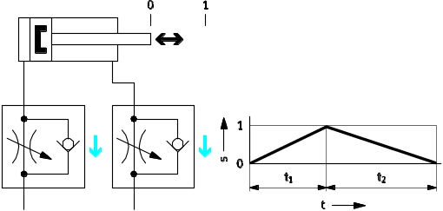
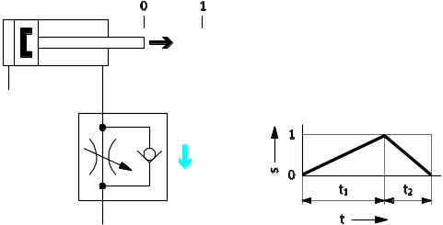
Flow Control

Slide 25

3/2 and 4/2 Way Valve – Working Principle

Slide 26


4/2-Way Solenoid Valve
5/2-Way-Valve Monostable
5/2-Way-Valve Bistable

Slide 27

5/2-Way-Valve - Cut-Away Drawing

Slide 28

5/2-Way-Valve – Cut Away Drawing (II)

Slide 29


Mechanical Grippers - Types

Slide 30


Mechanical Grippers – Working Principle
Housing
Gripper jaws
Bearings
slider
Piston

Slide 31



Vacuum Grippers – Working Principle
Vacuum generator
Suction Cup
1 Supply port
2 Vacuum port
3 Exhaust port

Slide 32


Inline-Type Vacuum Generator
P
V
R
P Supply port
V Vacuum port
R Exhaust port

Slide 33

Lorentz-Force

Slide 34

DC-Motor – Working Principle

Slide 35


DC-Motor – Picture and Symbol

Slide 36



Solenoid

Slide 37



Programmable Logic Controllers

Slide 38
Open and Closed Loop Control
x
Process
y
x
Controller
Process
y

